Slide 1
MSFE University of Illinois Colloquium
November 22, 2013
Chicago
Eric Hunsader

Slide 2
Fifth Third Bancorp ~ Market Cap: $17 Billion
November 19, 2013
http://www.nanex.net/aqck2/4489.html
During Algo's 10 second reign:
330,000 shares traded - 5% of daily average
Price swung $1.02 - 3x daily average

Slide 3
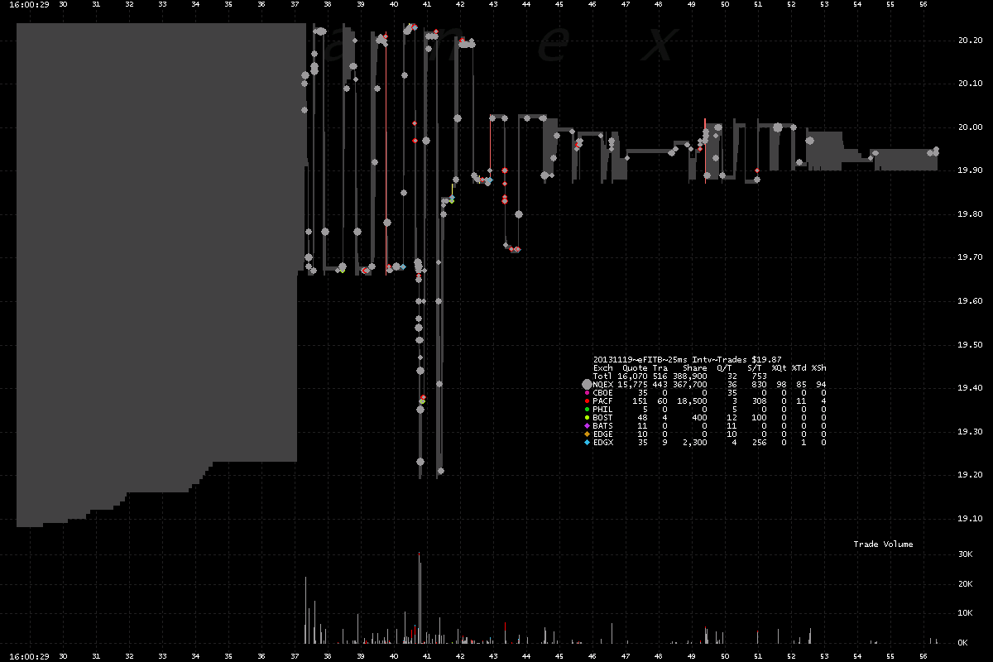

Slide 4
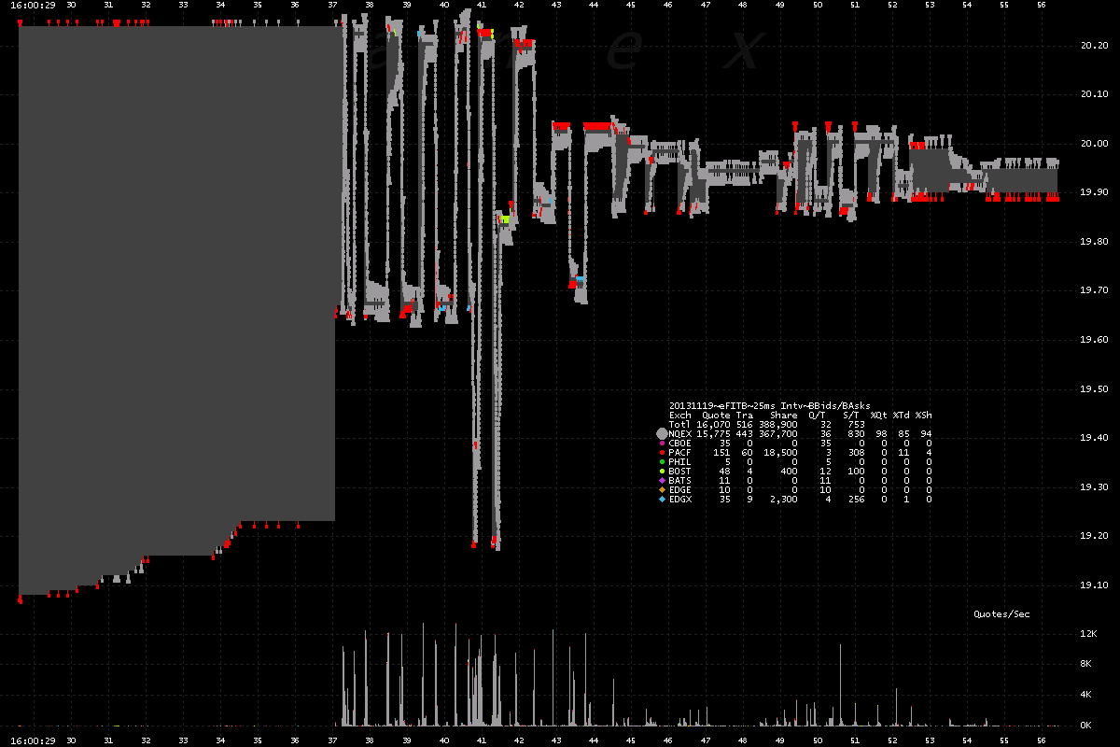

Slide 5
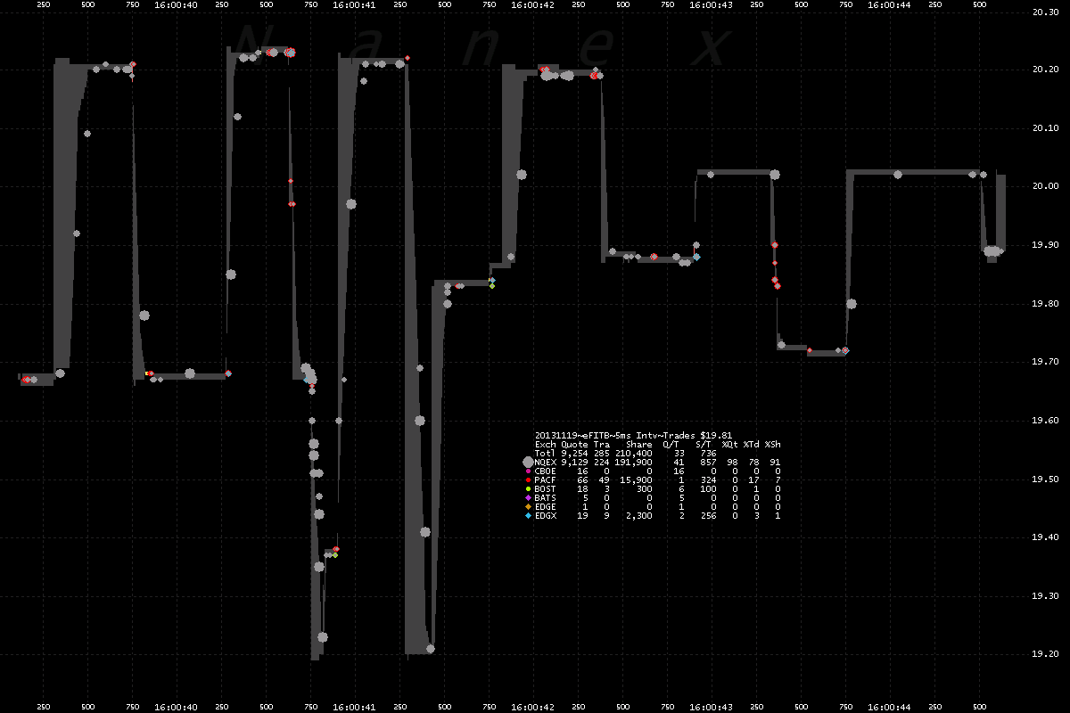

Slide 6
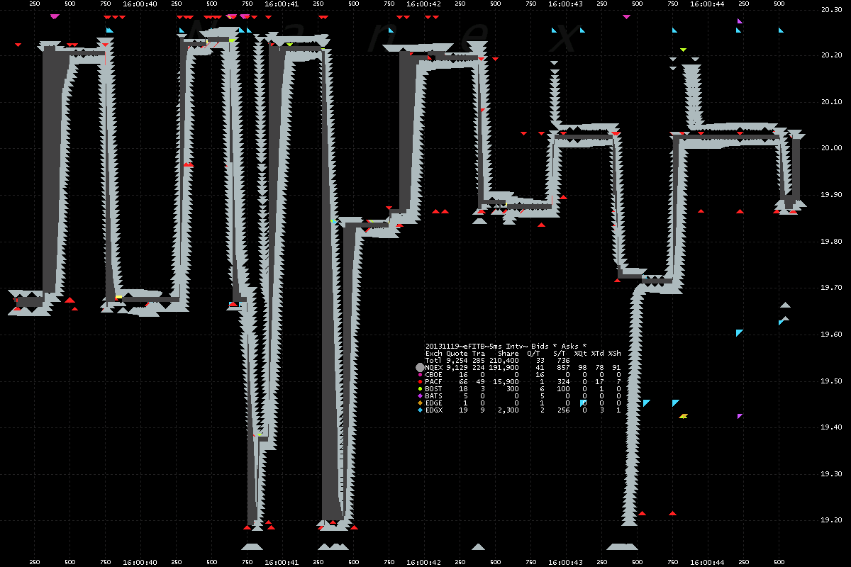

Slide 7
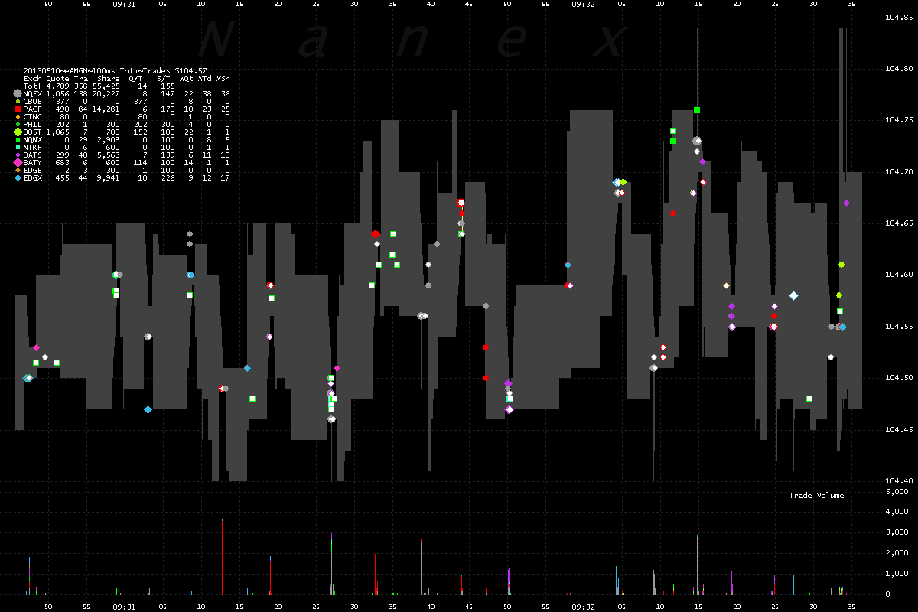

Slide 8
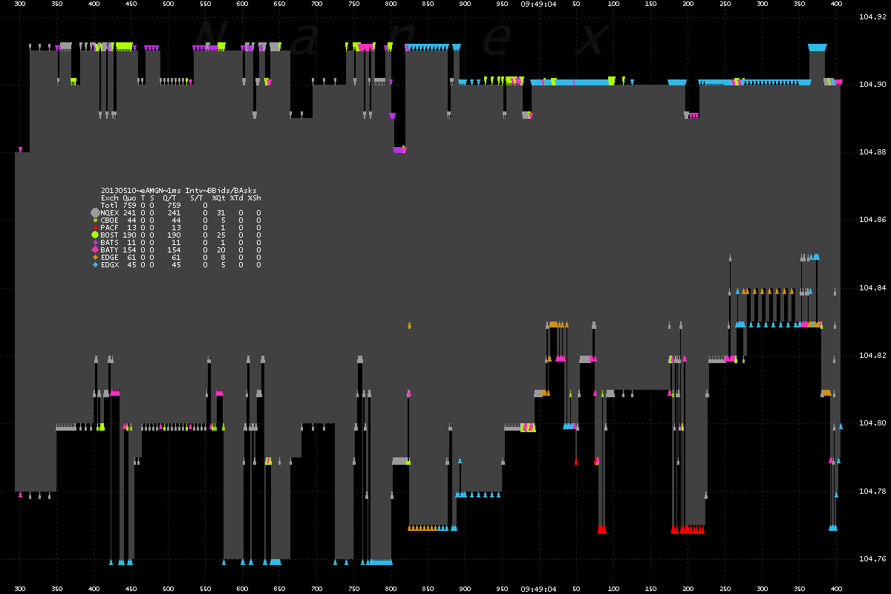

Slide 9
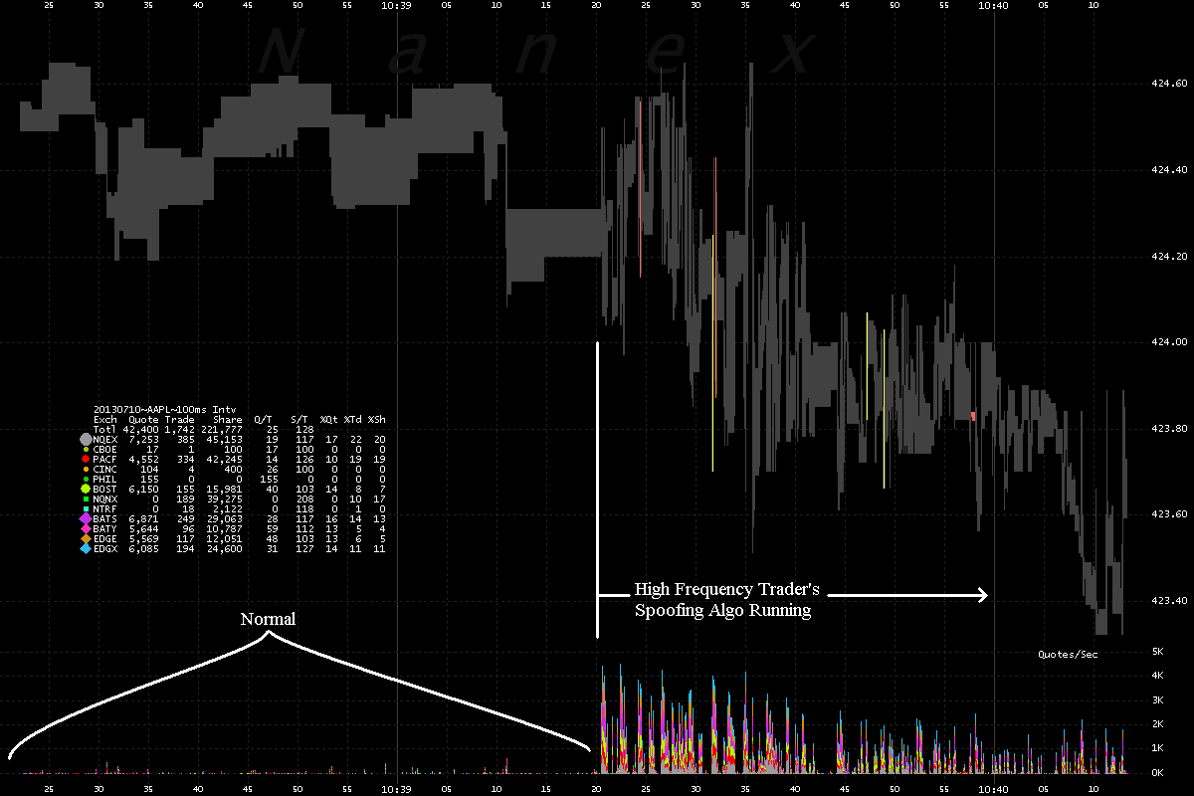

Slide 10
Apple Computer Corp
July 10, 2013
http://www.nanex.net/aqck2/4352.html

Slide 11
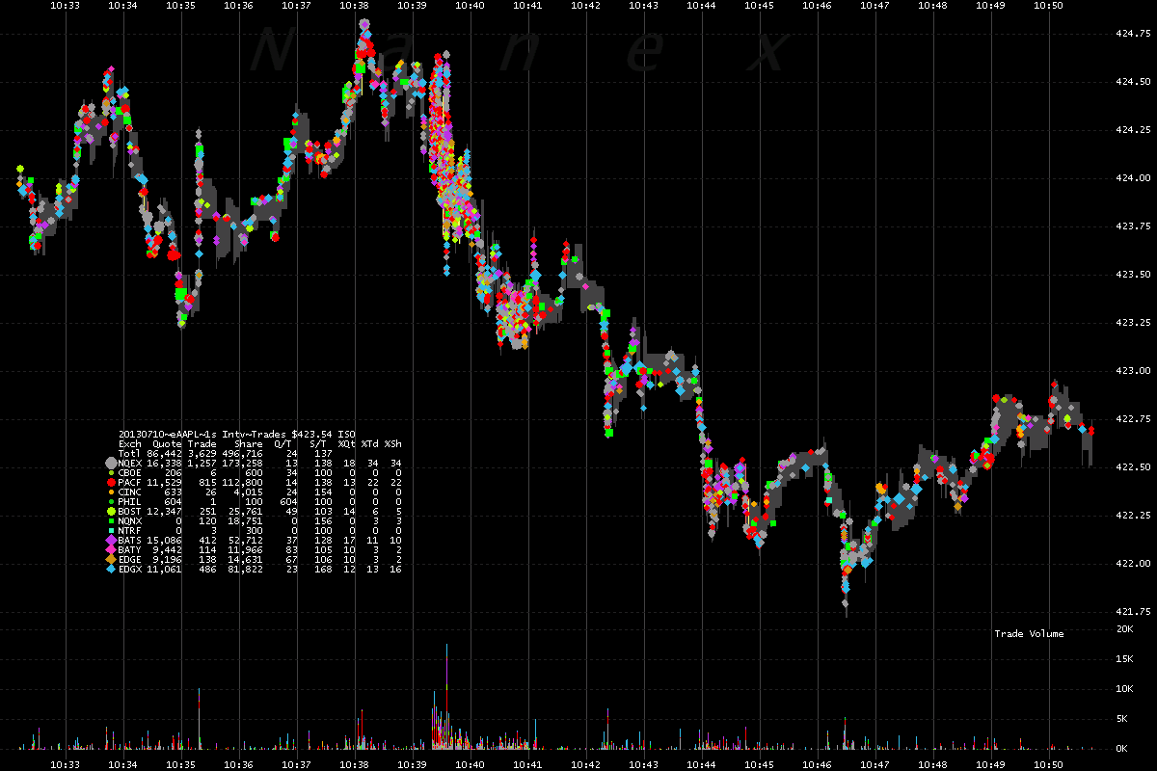

Slide 12
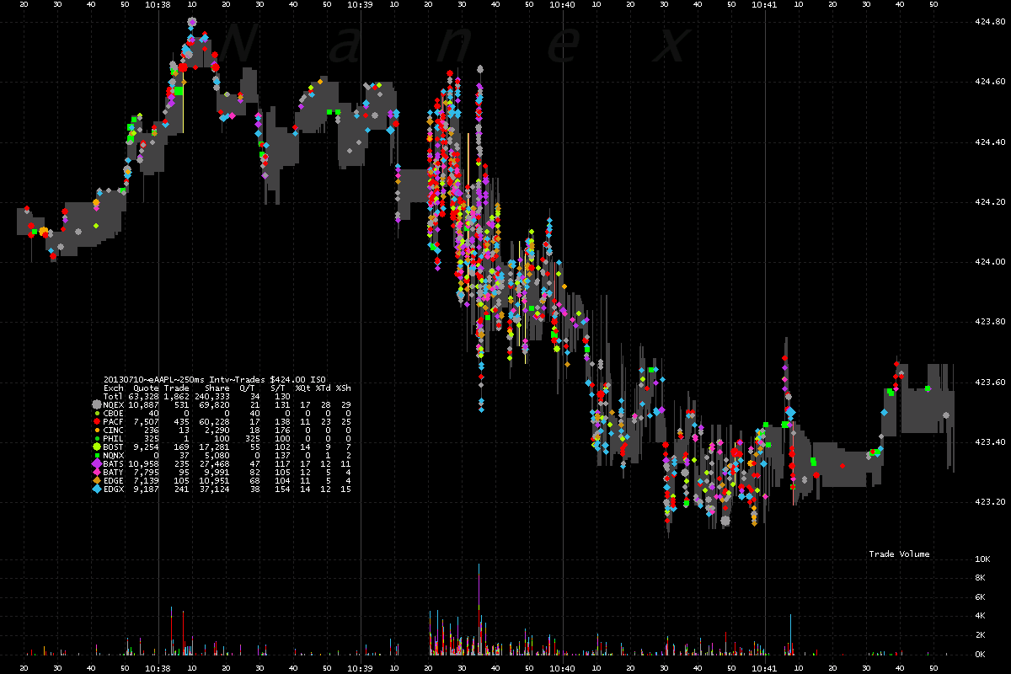

Slide 13
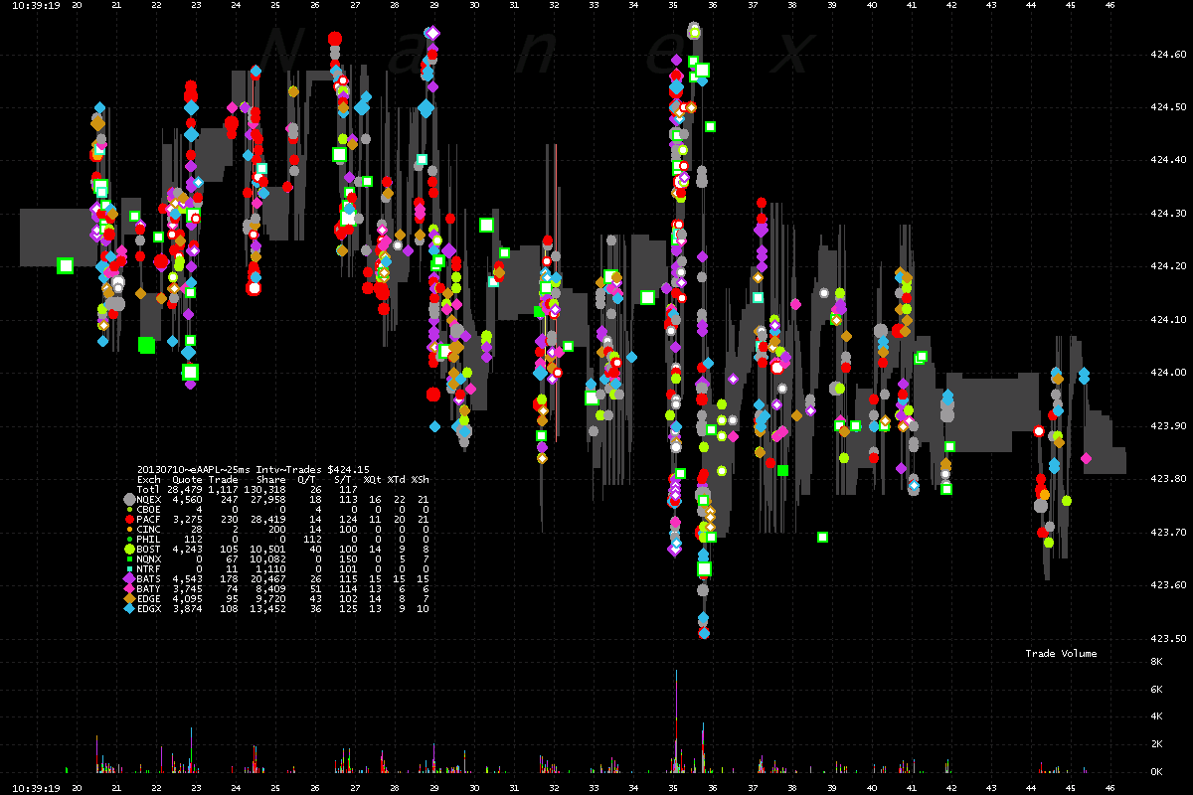

Slide 14
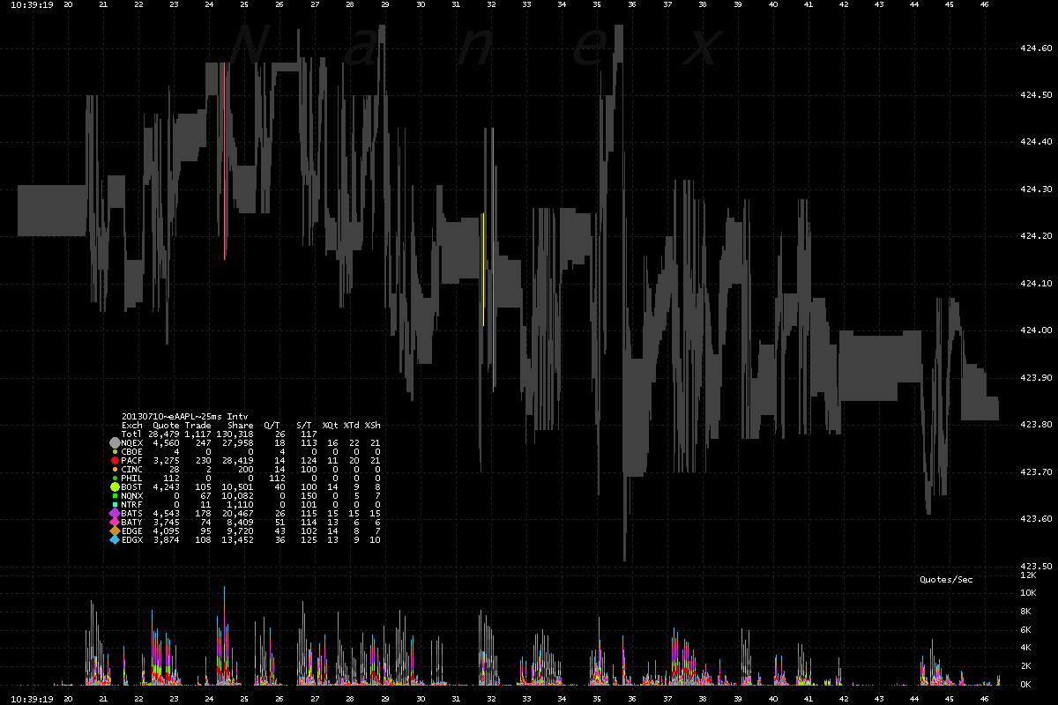

Slide 15
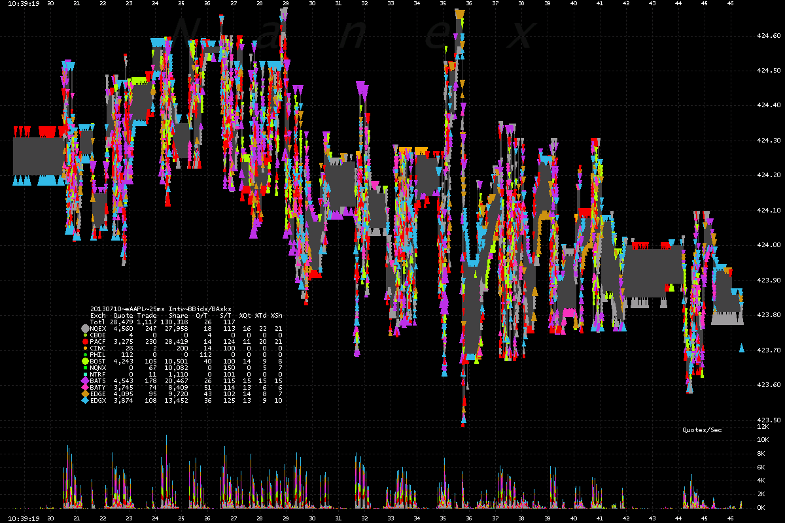

Slide 16
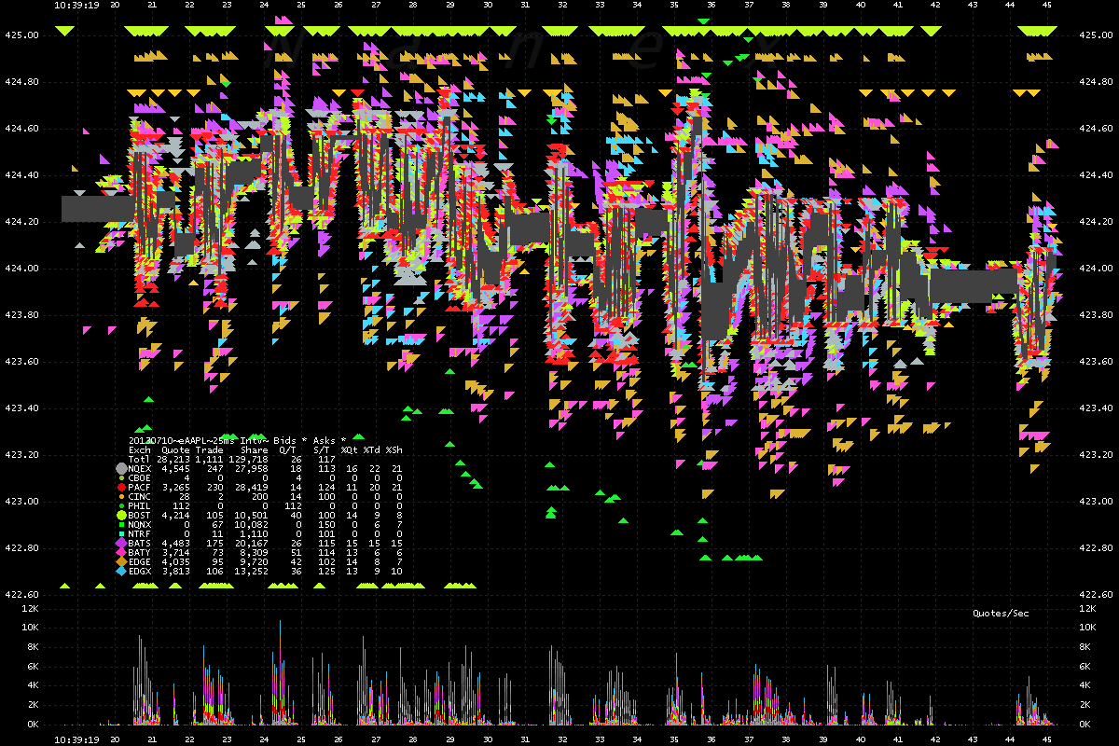

Slide 17
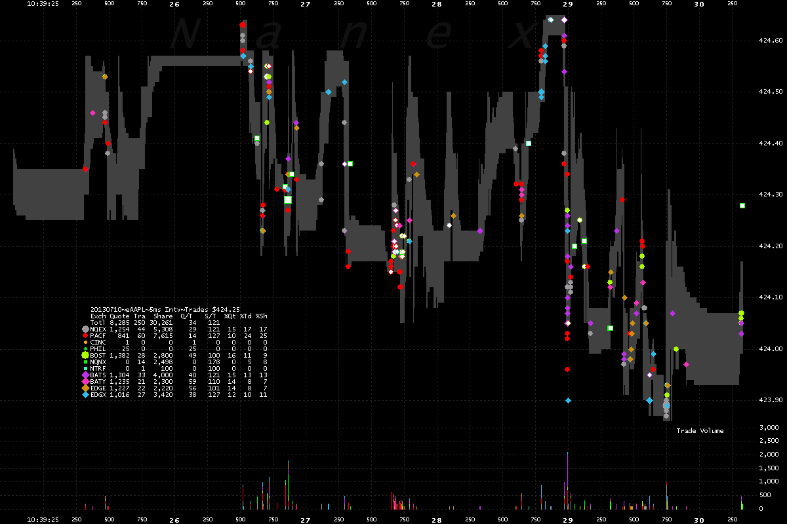

Slide 18
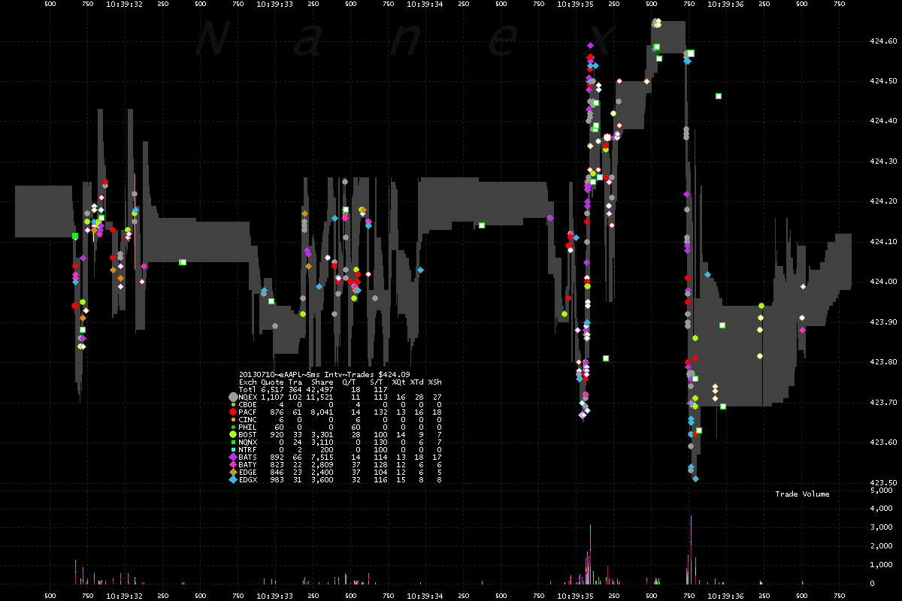

Slide 19
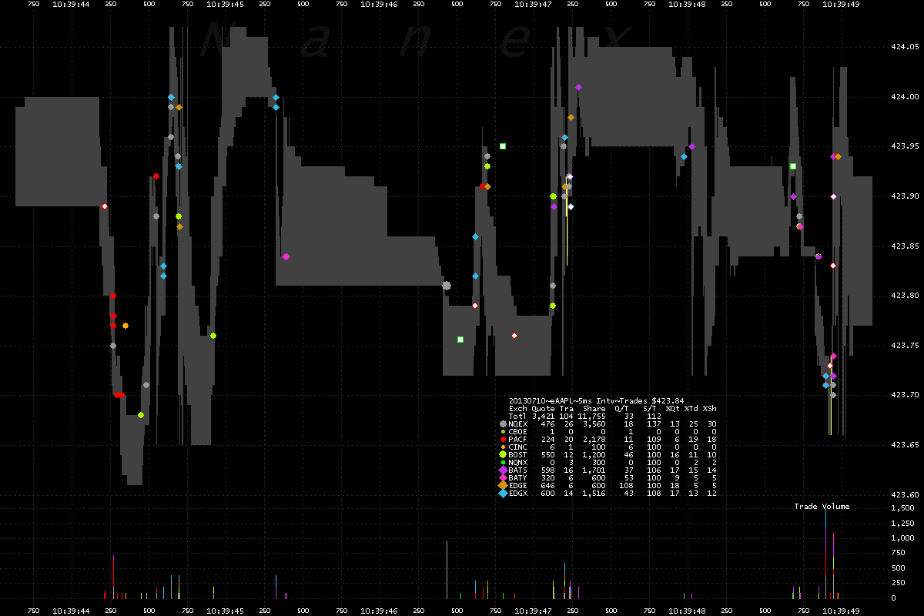

Slide 20
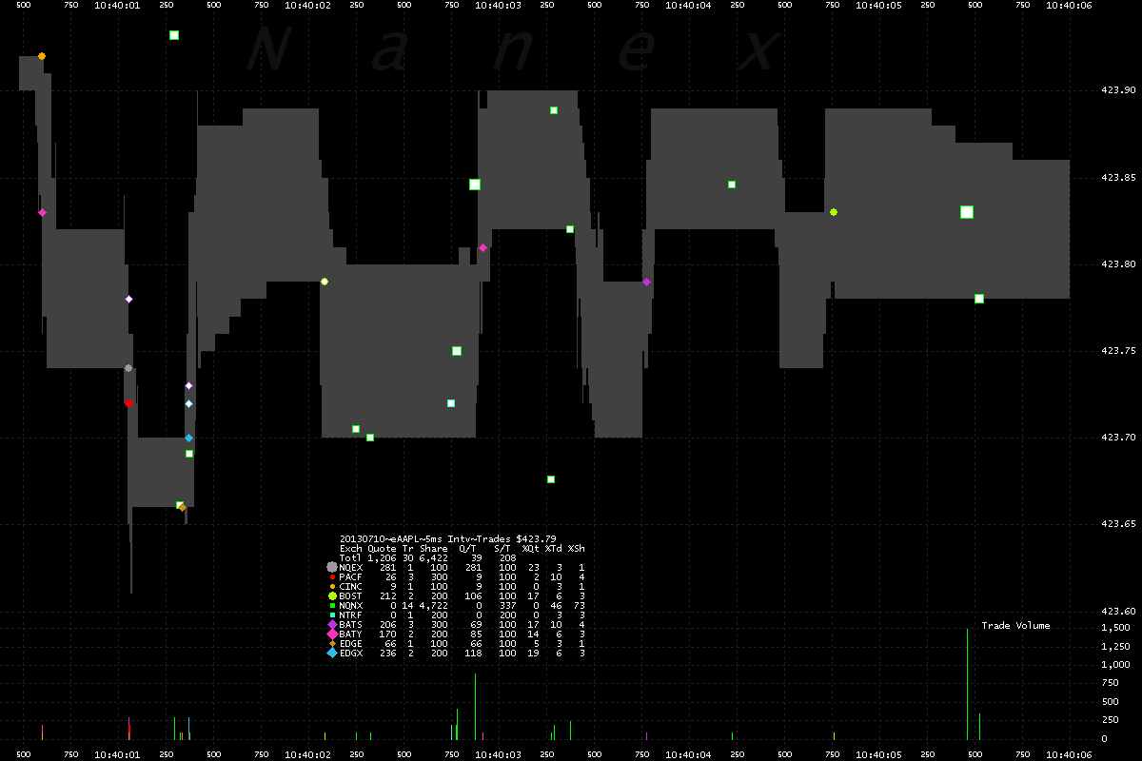

Slide 21
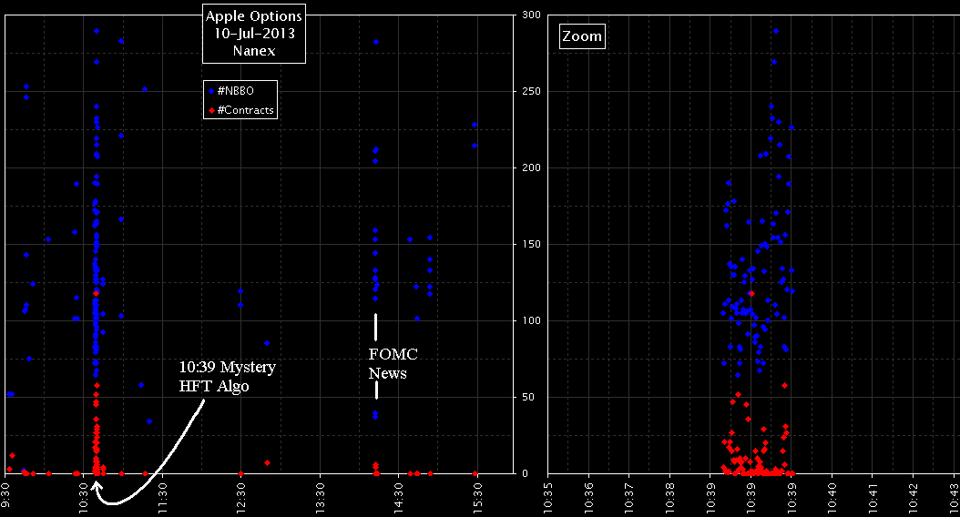

Slide 22
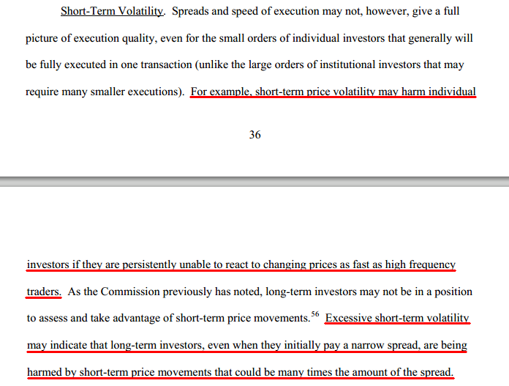

Slide 23
Regulation NMS
From Page 410:
But in those limited contexts where the interests of long-term investors conflict with short-term trading strategies, the conflict cannot be reconciled by stating that the NMS should benefit all investors. In particular, failing to adopt a price protection rule because short-term trading strategies can be dependent on millisecond response times would be unreasonable in that it would elevate such strategies over the interests of millions of long-term investors – a result that would be directly contrary to the purposes of the Exchange Act.

Slide 24
Regulation NMS
Page 30:
..one of the Commission's most important responsibilities is to preserve the integrity and affordability of the consolidated data stream.
Page 32:
The Commission particularly is concerned that the integrity and reliability of the consolidated data stream must not be compromised by any changes to the market data structure.

Slide 25
